Slide 1


Potential value of cardiac magnetic resonance obtained long-axis right ventricular displacement in the evaluation of patients with pulmonary arterial hypertension
Sophia-Anastasia Mouratoglou,¹ Alexandros Kallifatidis,² George Giannakoulas,¹ Julia Grapsa,⁴ Vasileios Kamperidis,¹ Georgia Pitsiou,³ Ioannis Stanopoulos,³ Stavros Hadjimiltiades,¹ Haralambos Karvounis¹
Aristotle University
of Thessaloniki
1st Department of
Cardiology, AHEPA
University Hospital
¹Aristotle University of Thessaloniki, 1st Cardiology Department, AHEPA University Hospital, Thessaloniki, Greece
²St. Luke's Hospital, Radiology Department
³Aristotle University of Thessaloniki, Respiratory Failure Unit, G. Papanikolaou General Hospital, Thessaloniki, Greece
⁴Royal Brompton and Harefield NHS Foundation Trust, Department of Cardiology, London, United Kingdom

Slide 2
Purpose
Echocardiographically obtained tricuspid annular plane systolic excursion (echo-TAPSE) is an established non invasive parameter for the evaluation of right ventricular (RV) function in patients with pulmonary arterial hypertension (PAH). There is, however, scarce data on the use of cardiac magnetic resonance (CMR) in the assessment of PAH patients. The aim of our study is to reveal the potential value of CMR in the evaluation of RV dysfunction as expressed by long-axis RV displacement (CMR-TAPSE).

Slide 3
Methods
This is a prospective cross sectional study. All patients underwent cardiac magnetic resonance (CMR), (Siemens AVANTO 1,5T). A routine set of LV and RV short-axis cines of 6mm slice thickness, were acquired from base to apex using a breath-hold retrospective ECG-gated balanced steady state free precession (SSFP) sequence.
CDi (duration of septal curvature configuration x 100/cardiac cycle duration), left ventricular eccentricity index in end-systole (LVSei) and end-diastole (LVDei). Interventricular septal curvature ratio (CR) was defined in the same level, at end-systole. Tricuspid annular plane systolic excursion (CMR-TAPSE) was defined in the 4-chamber view.
Echocardiographic study (Vivid 7, General Electric) was performed the same day with CMR for the assessment of echo-TAPSE from the M-Mode view

Slide 4
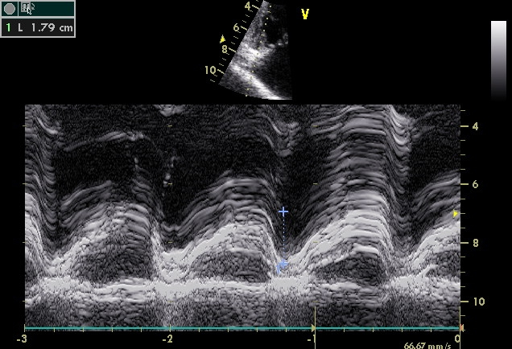
TAPSE calculation
A, B, C: CMR 4ch view. The straight-line distance travelled by the lateral tricuspid annulus from end-diastole (A) to end-systole
(B) is used for the determination of CMR-TAPSE (C)
D: Echocardiographic study. Echo-TAPSE is calculated with M-mode, measuring the distance of tricuspid annular movement between end-diastole to end- systole (green line)
A
B
C
D

Slide 5
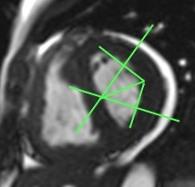
Short-axis view. Eccentricity index calculation in end-diastole (A) & end-systole (B) and curvature ratio calculation in end-systole (C).
A
B
C

Slide 6
Results
Our study included 16 patients (12 women, mean age 46.3±12.5 years) with precapillary pulmonary hypertension (2 with idiopathic PAH, 6 with PAH associated to congenital heart disease, 2 with PAH associated to connective tissue disease and 2 with chronic thromboembolic pulmonary hypertension). A direct linear correlation between CMR-TAPSE and echo-TAPSE (r= 0.625, p=0.01), CR (r=0.509 p<0.05), CDi (r=-0.680 p=0.004), LVSei (r=-0.732 p=0.002) and LVDei (r=-0.625 p=0.01) was observed (Table).

Slide 7
Table
 |  | Bivariate correlation
Parameter | mean ± SD | r | p
CMR-TAPSE (cm) | 1.4±0.4
CDi (%) | 66.8±19.5 | -0.680 | 0.004
CR | 0.6±0.2 | 0.509 | <0.05
LVSei | 1.7±0.5 | -0.732 | 0.002
LVDei | 1.4±0.2 | -0.625 | 0.01
Echo-TAPSE (cm) | 1.8±0.3 | 0.625 | 0.01
CMR-TAPSE: tricuspid annular plane systolic excursion obtained by CMR
echo-TAPSE: tricuspid annular plane systolic excursion obtained by echocardiography
CDi: curvature duration index, CR:curvature ratio
LVSei-LVDei:left ventricular eccentricity index in end-systole and end-diastole.

Slide 8
Conclusion
CMR is a useful tool for the non invasive and reproducible evaluation of RV function and pressure overload of PAH patients.

Slide 9
Study is funded by the Hellenic Society of Cardiology
Corresponding author:
Alexandros Kallifatidis
St.Luke’s Hospital,
Department of Radiology,
Panorama, 55236, Thessaloniki, Greece
email: alexandros.kallifatidis@yahoo.gr

Slide 10
References
1.Dellegrotalie S, Sanz J, Poon M, et al. Pulmonary Hypertension: accuracy of detection with left ventricular septal-to-free wall curvature ratio measured at cardiac MR. Radiology 2007; 243(1):63-9
2. Chen SSM, Keegan J, Dowsey AW et al. Cardiovascular magnetic resonance tagging of the right venricular free wall for the assessment of long axis myocardial function in congenital heart disease. J Cardiovasc Magn Reson 2011;13(1):80-9

